Slide 1
Job market analysis

Slide 2
Introduction
This project analyses trends in the U.S. job market, focusing on data science roles. The dataset contains 742 job listings with 42 details such as job titles, salary estimates, company information, and required skills.
The main goal is to identify the most in-demand skills, qualifications, job responsibilities and provide insights that can inform job seekers and employers.

Slide 3
Attribute Information
The dataset includes the following information:
Job Title: The title of job, eg. Data scientist, junior data scientist, senior data scientist etc.
Salary Estimate: Range of salary.
Job Description: Tells us what is expected out of the job title.
Rating: It gives the rating of the company
Company Name: Name of the company
Location: Location of the job
Headquarters: location of headquarter of the company
Size: Range of number of employee working in the company

Slide 4
Industry: Industry of the company
Sector: Sector in which company works
Revenue: Total revenue of the company per year
Competitors: Current competitor of the company in the same sector
Hourly: Tells us if the salary reported was hourly or yearly.
1: Hourly, 0: not hourly.
Employer provided: 1: If the salary was provided by the employee of the company, 0: otherwise.
Lower Salary: Lower salary reported for the job.
Upper Salary: Upper salary reported for the job.

Slide 5
Founded: Company founded in Year
Type of ownership: Tells us if the company is private, public or government owned.
Avg Salary(K): Average of Lower and Upper salary yearly. K is the unit of the column, it means 1000. Also, the salary is in ($) U.S. dollars.
company_txt: It contains the name of the company.
Multiple skill columns (python, spark, aws, excel etc): 1: Skill is required by the company, 0: It is not required.
Jobtitle_sim: It contains the title of the job like Data scientist, ML engineer etc.
seniority_by_title: Seniority of the position, it is extracted from the Job Title.
Degree: If the job description mention that the company gives experience credit for a master(M) or Ph.D degree(P).

Slide 6
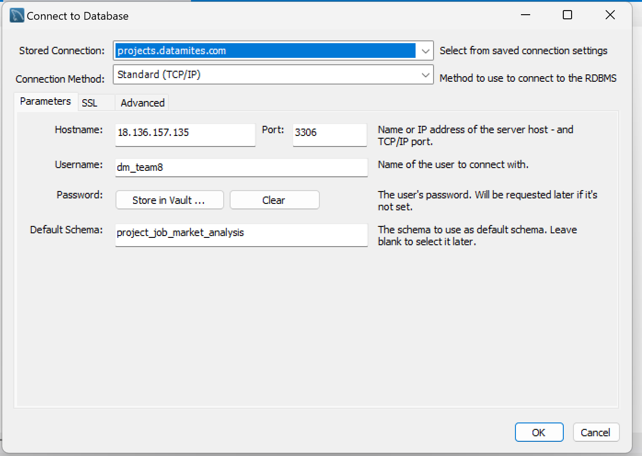
Key Insights
Get data from database with the given credentials
Connect the database with My SQL Workbench using the credentials provided

Slide 7
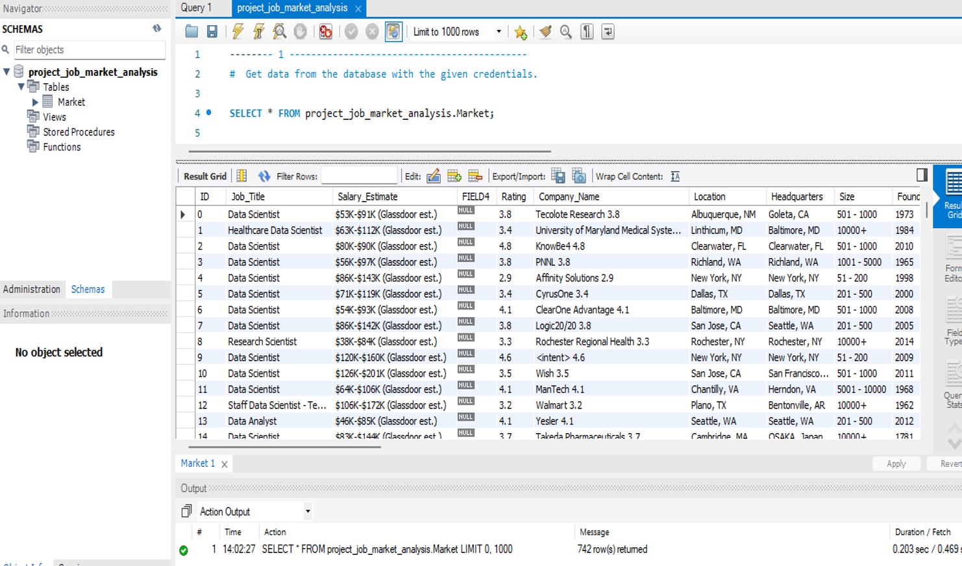
Now using SQL query (select * from table name) get the data

Slide 8
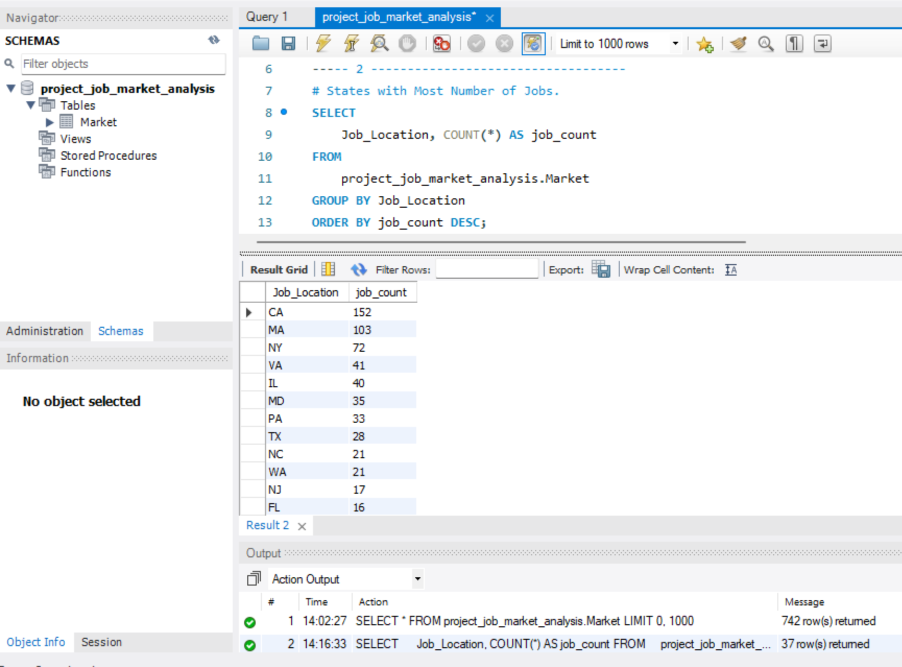
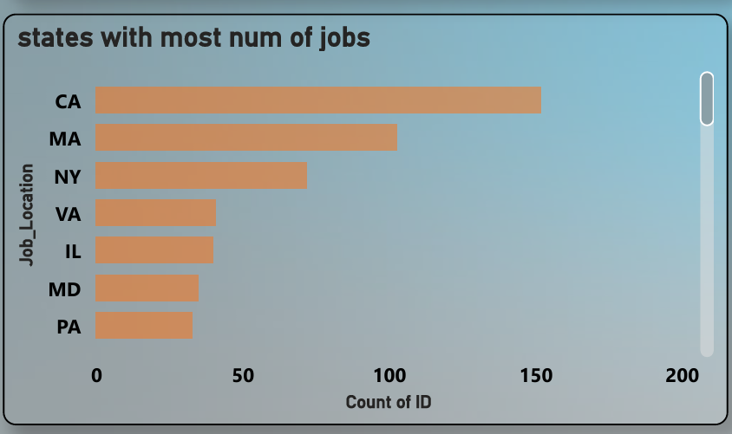
2. States with most number of jobs
California, Massachusetts, and New York have the most data science job listings, showing that tech jobs are concentrated in these states.
SQL Output
Power Bi Output

Slide 9
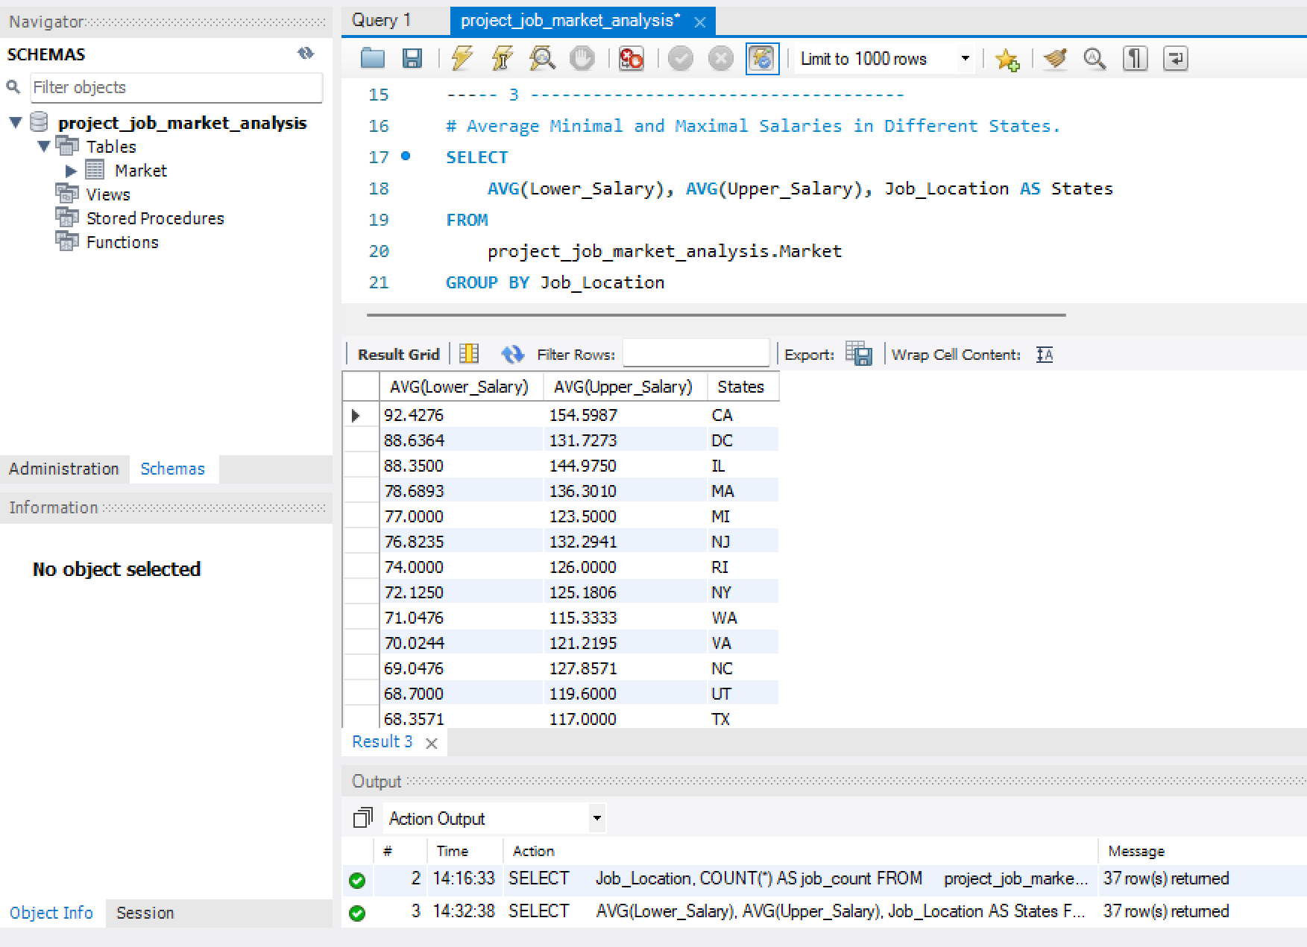
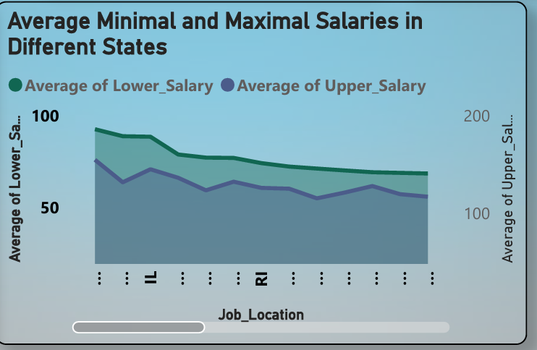
3. Average Minimal and Maximal Salaries in Diff .States
Salaries vary widely by state, with higher averages in states like California, and lower averages in states like Texas and Utah.
SQL Output
Power Bi Output

Slide 10
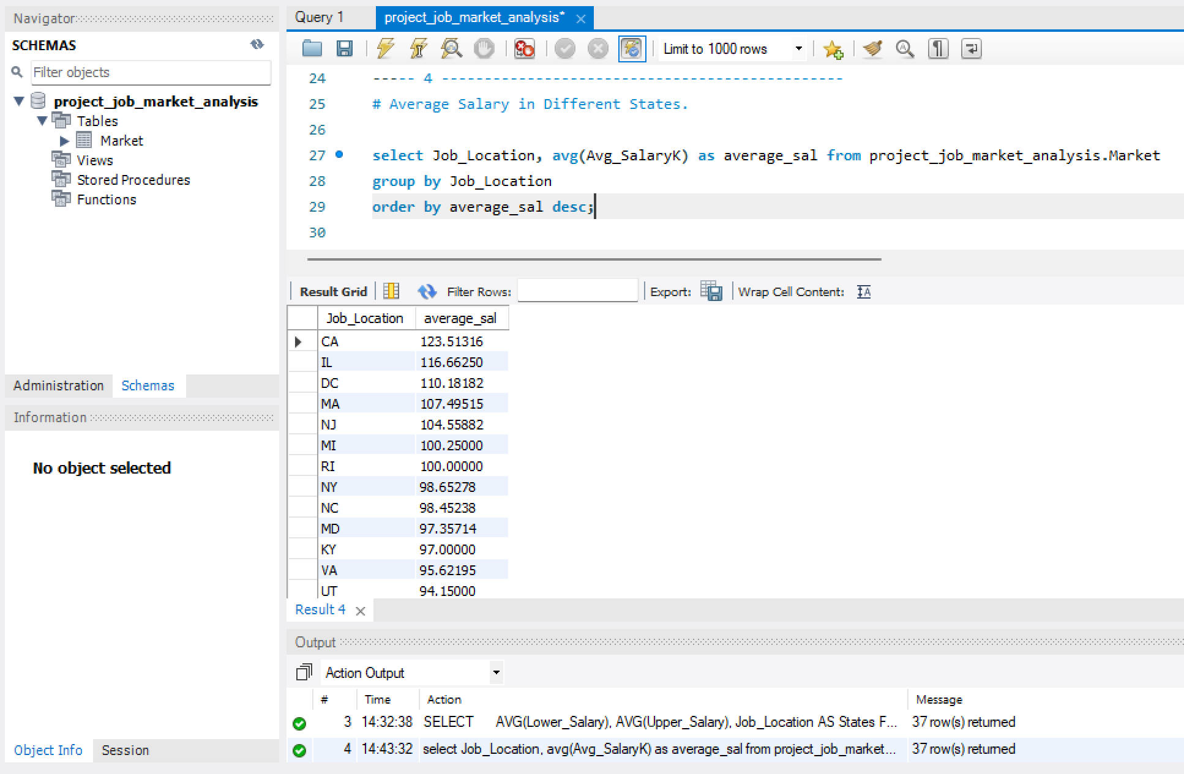
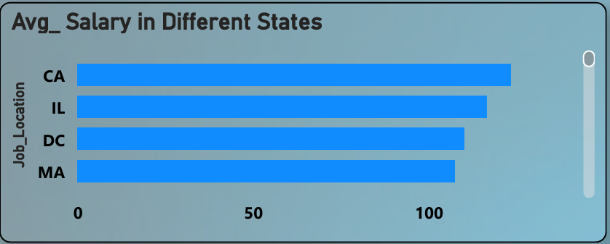
4. Average Salary in Different States
The table shows average salaries by job location, calculated and ordered from highest to lowest. California leads with $123.51K, followed by Illinois and Washington, D.C., highlighting regional salary trends in the job market.
SQL Output
Power Bi Output

Slide 11
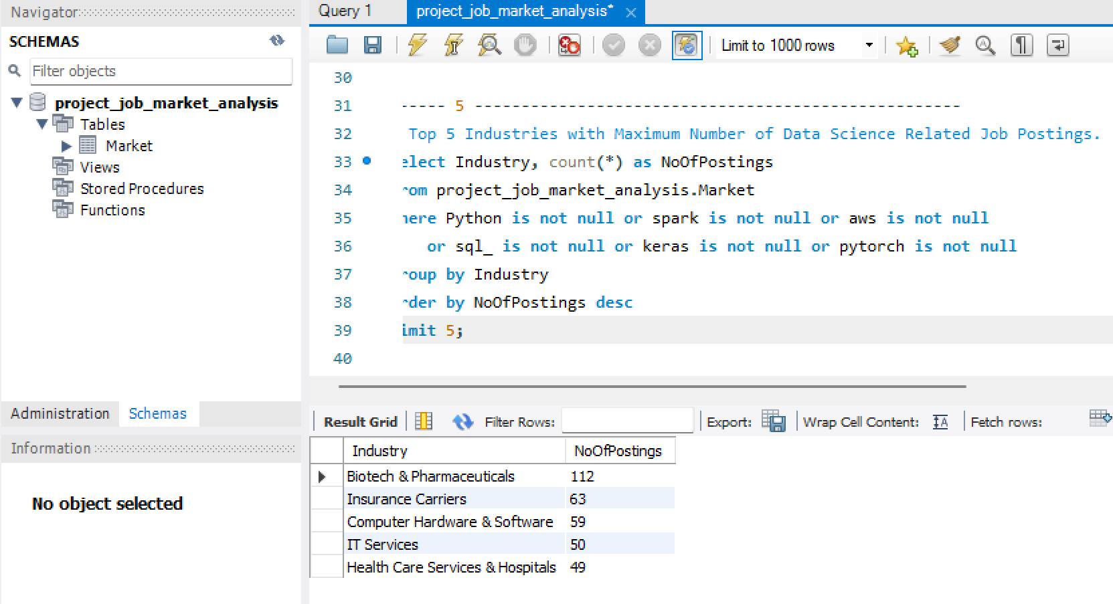
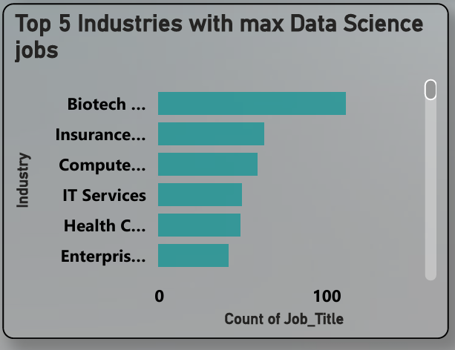
5. Top 5 Industries with Maximum Number of Data Science Related Job Postings.
The table highlights the top 5 industries with the most data science job postings.
1.Biotech & Pharmaceuticals (112)
2. Insurance Carriers (63)
3. Computer Hardware & Software (59).
4.IT Services(50)
5. Health Care Services & Hospitals (49)
SQL Output
Power Bi Output

Slide 12
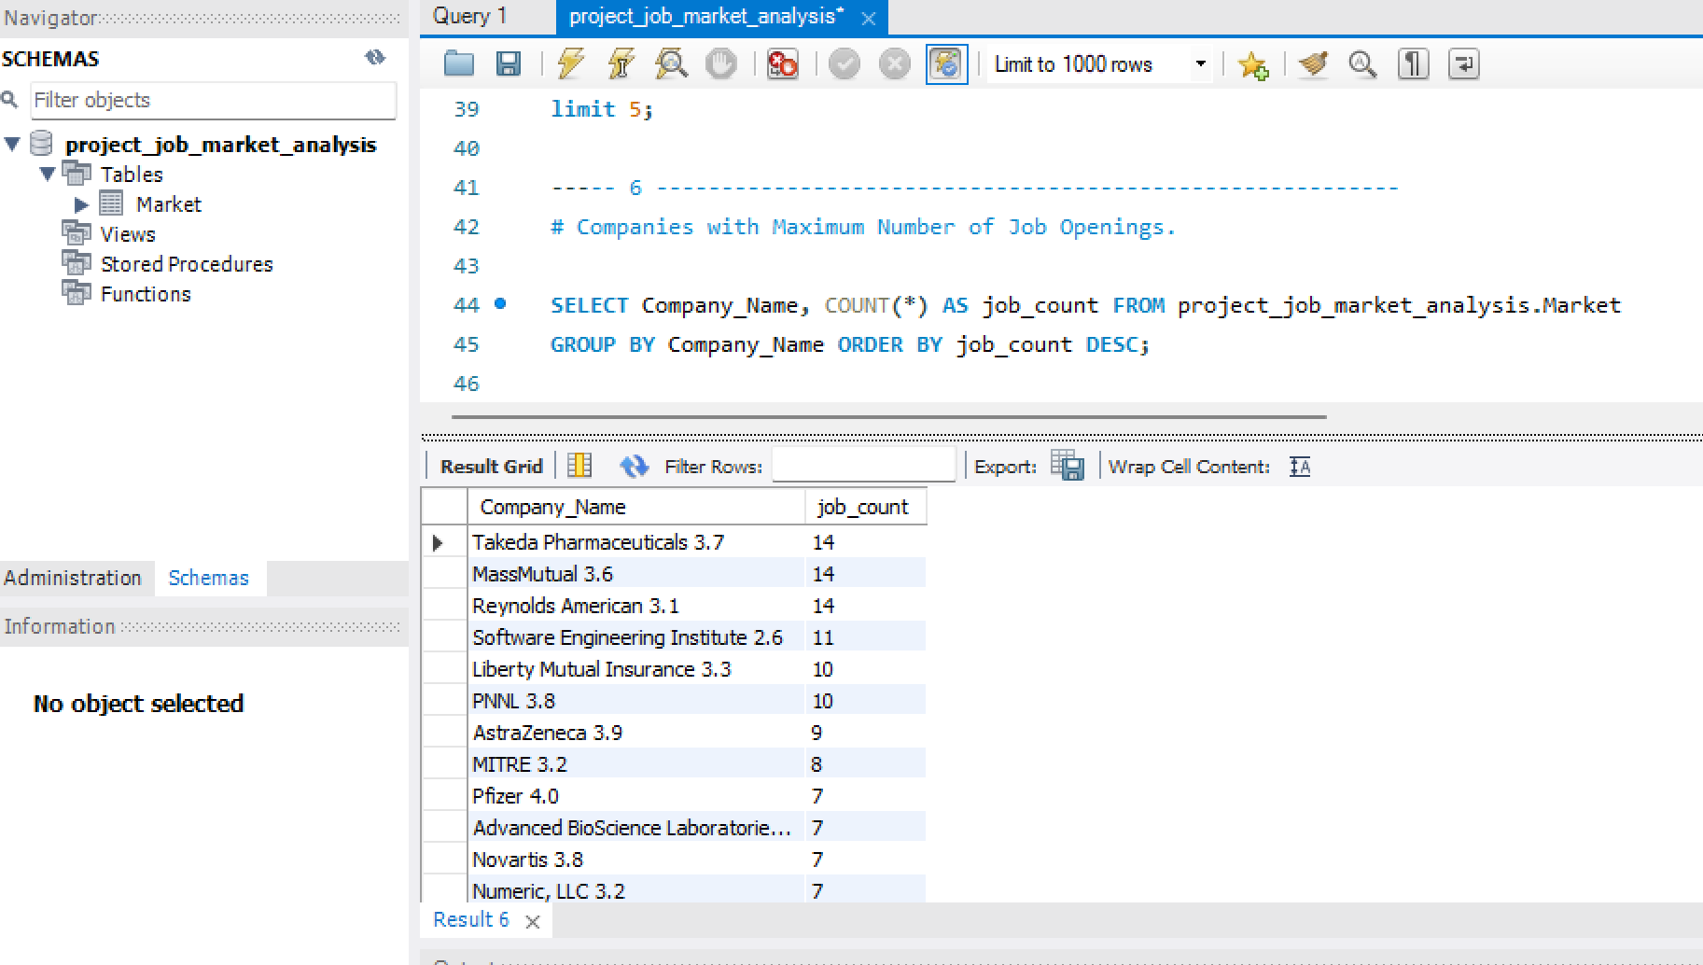
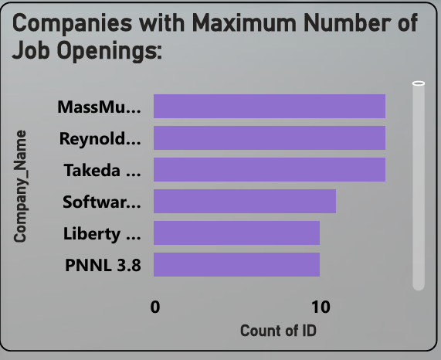
6. Companies with Maximum Number of Job Openings.
The companies with the highest number of job openings are Takeda Pharmaceuticals, MassMutual, and Reynolds American, each with 14 positions available. Other top employers include Software Engineering Institute with 11 openings and Liberty Mutual Insurance with 10 openings.
SQL Output
Power Bi Output

Slide 13
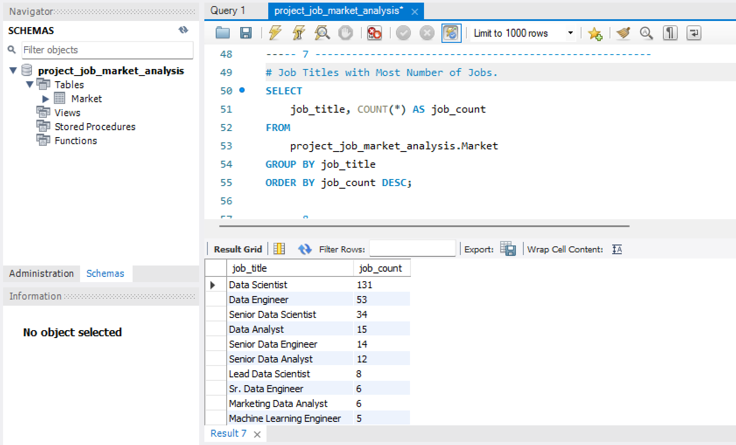
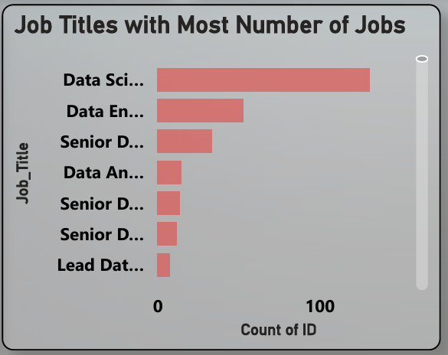
7. Job Titles with Most Number of Jobs.
The top job titles are Data Scientist (131 jobs), Data Engineer (53 jobs), and Senior Data Scientist (34 jobs). Other prominent roles include Data Analyst (15 jobs) and Senior Data Engineer (14 jobs).
SQL Output
Power Bi Output

Slide 14
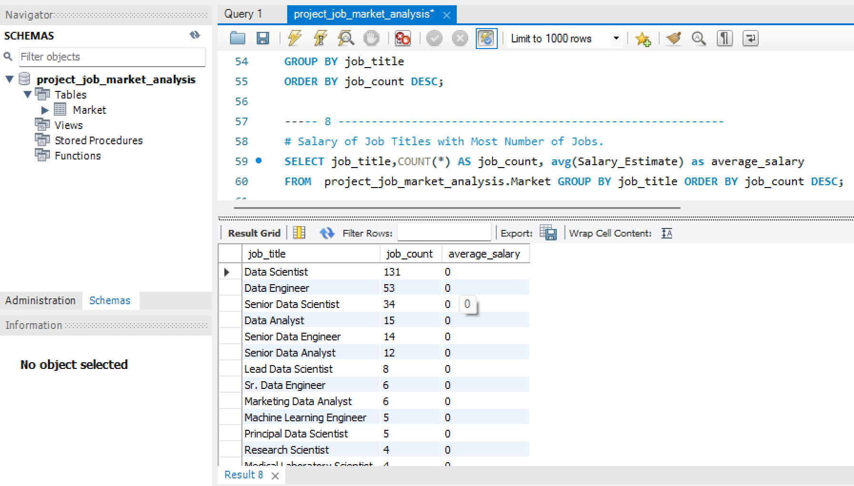
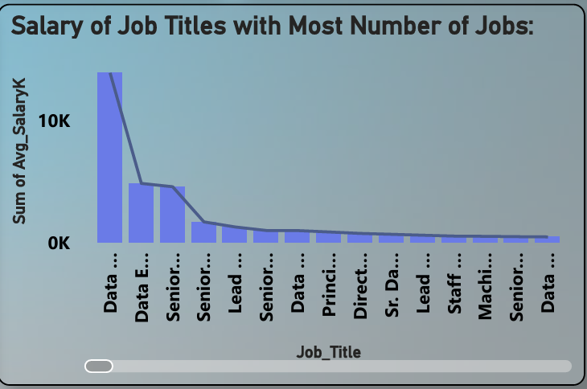
8. Salary of Job Titles with Most Number of Jobs.
SQL Output
Power Bi Output

Slide 15
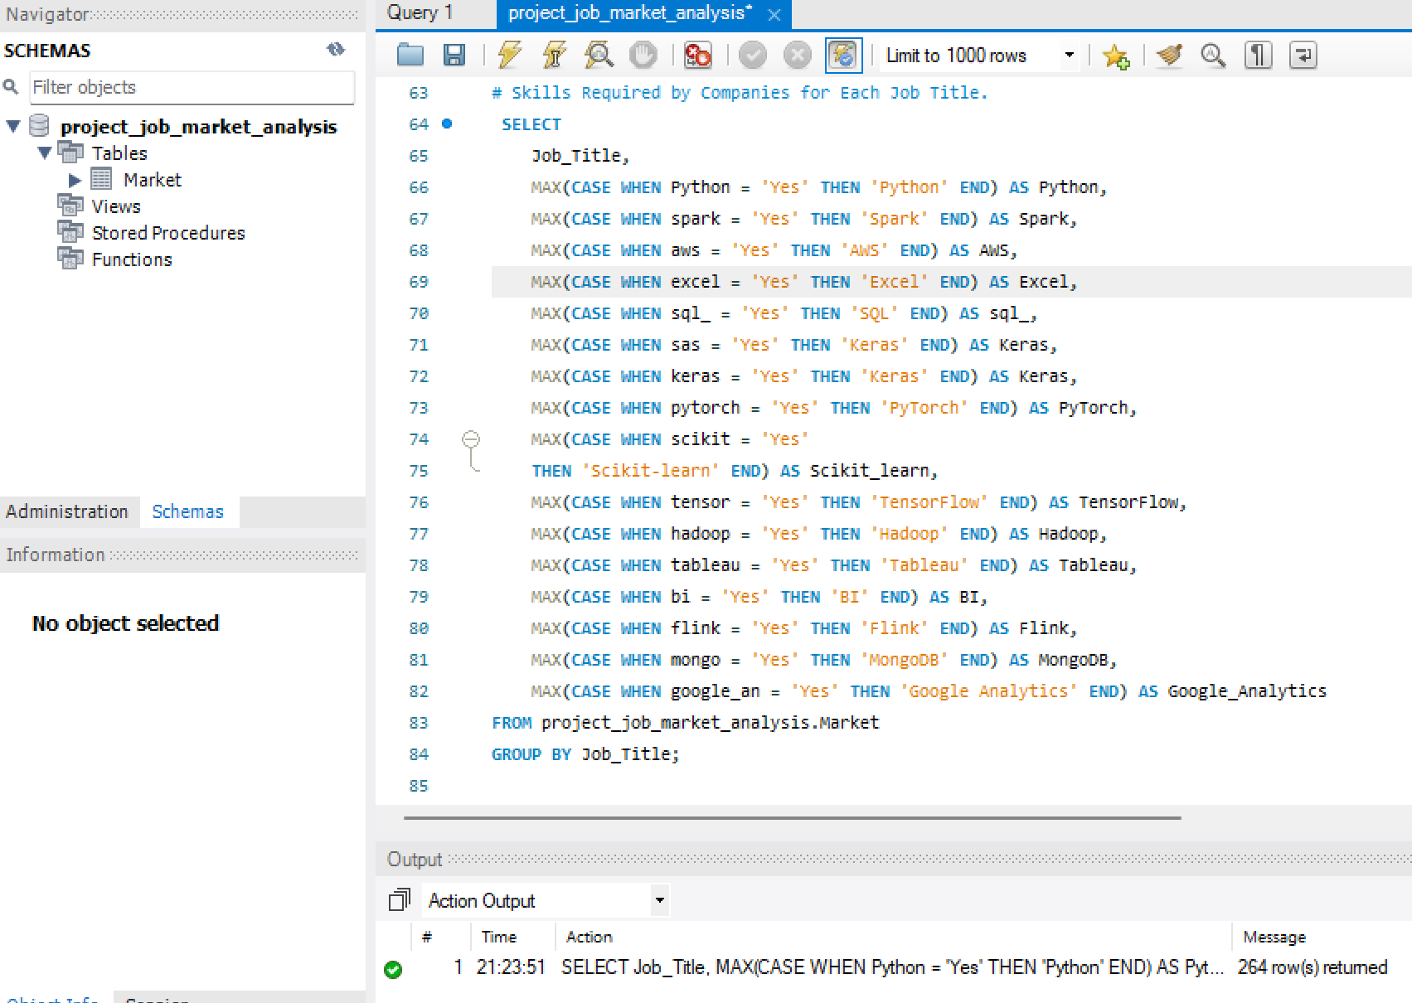
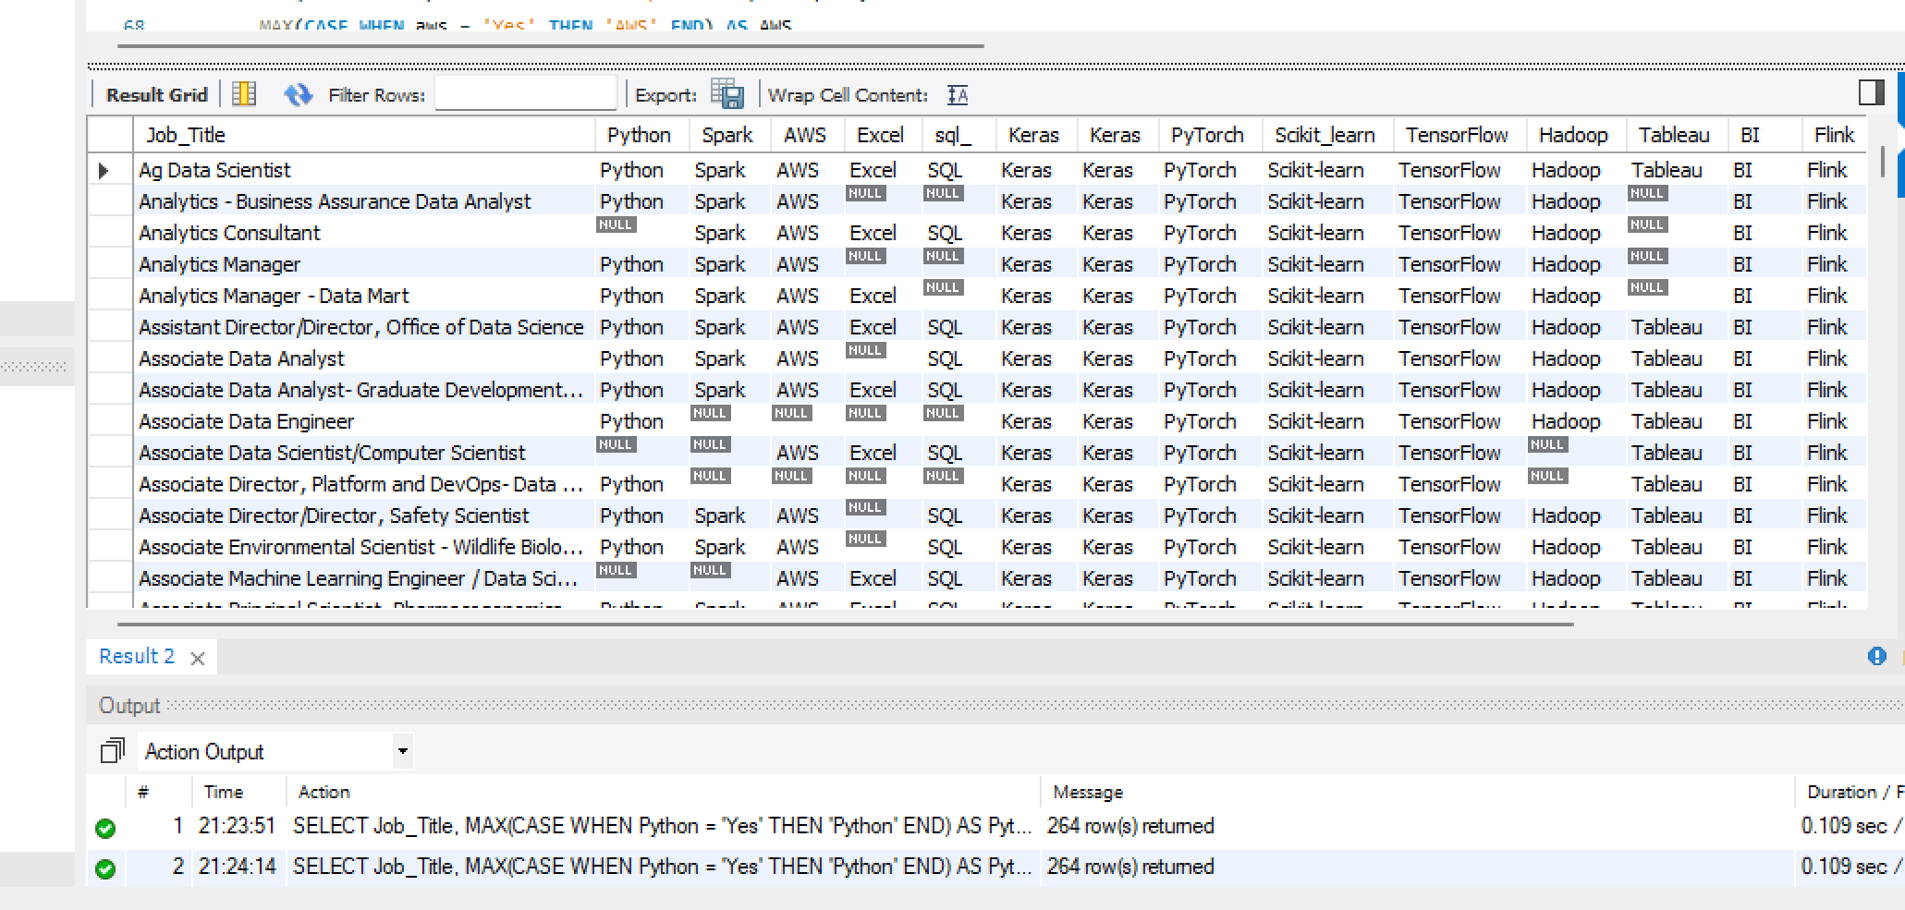
9. Skills Required by Companies for Each Job Title.
The key technical skills required for various job titles in the data science and analytics domain. Commonly sought-after skills include Python, SQL, AWS, and Tableau, with machine learning frameworks like TensorFlow, PyTorch, and Keras also frequently in demand for more advanced roles.

Slide 16
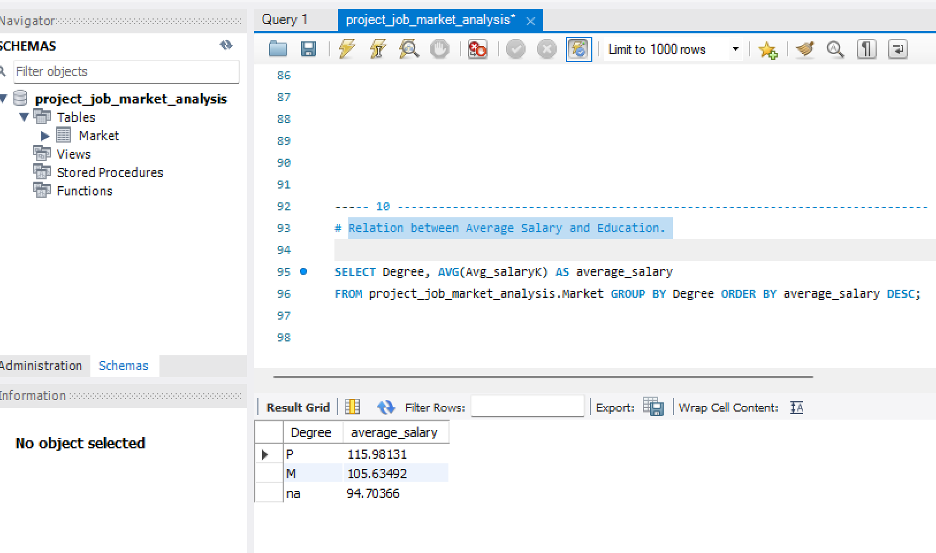
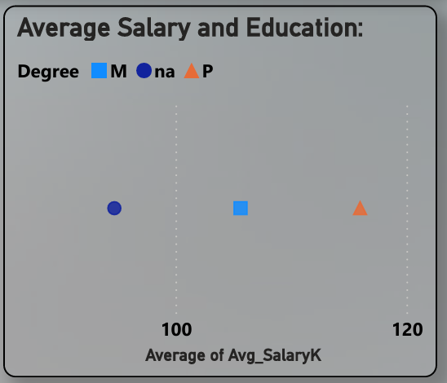
10. Relation between Average Salary and Education.
The analysis shows that higher education, like a Master's or Ph.D., leads to better-paying jobs. People with advanced degrees earn more on average compared to those with just a Bachelor's degree in the data science and analytics field.
SQL Output
Power Bi Output

Slide 17
Insights and suggestions based on the analysis:
Focus on High-Demand States: Companies should hire more in states with lots of jobs and pay fairly based on local trends. Job seekers should look for jobs in these states for better chances.
Top Skills & Qualifications: Companies should focus on hiring people with in-demand skills like Data Science and AI, and make sure job requirements match what’s really needed. Job seekers should learn these skills to stay ahead.
Fair Salaries: Make sure pay matches the current market rates, especially for jobs in high demand. Job seekers can use salary data to ask for higher wages.
Hiring for High-Demand Jobs: Companies should make the hiring process faster for roles with many openings. Job seekers should focus on these jobs to increase their chances of getting hired.
Education & Salary: Companies should consider education in salary decisions. Job seekers can boost earnings by pursuing relevant qualifications.

